Slide 1
404 team
Student Registration Status
Beirut AI
2021 Bootcamp

Slide 2
-01-
Team Formation
Who we are ?

Slide 3
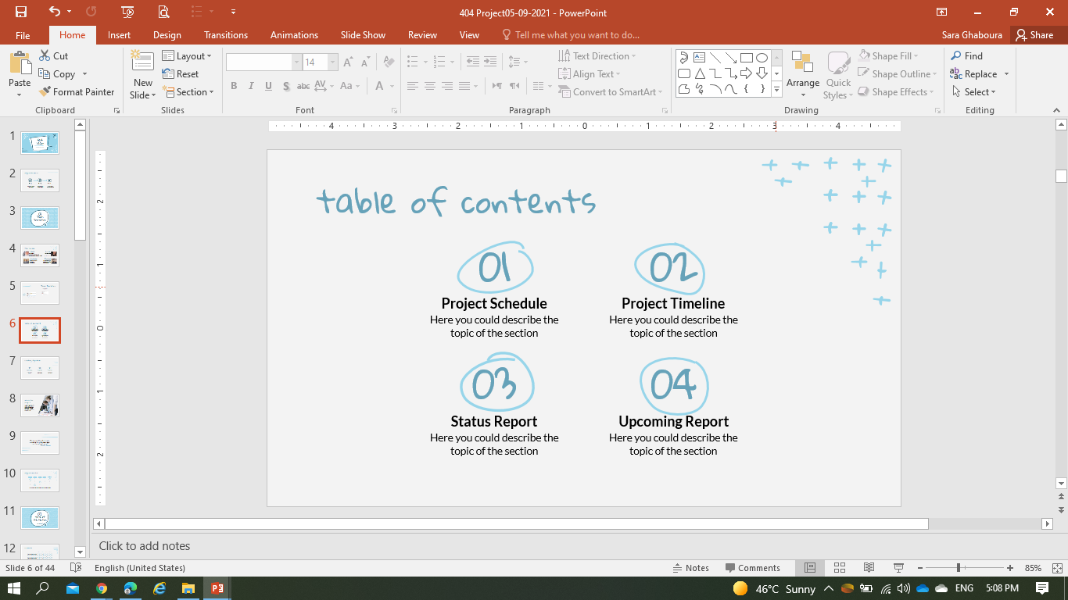
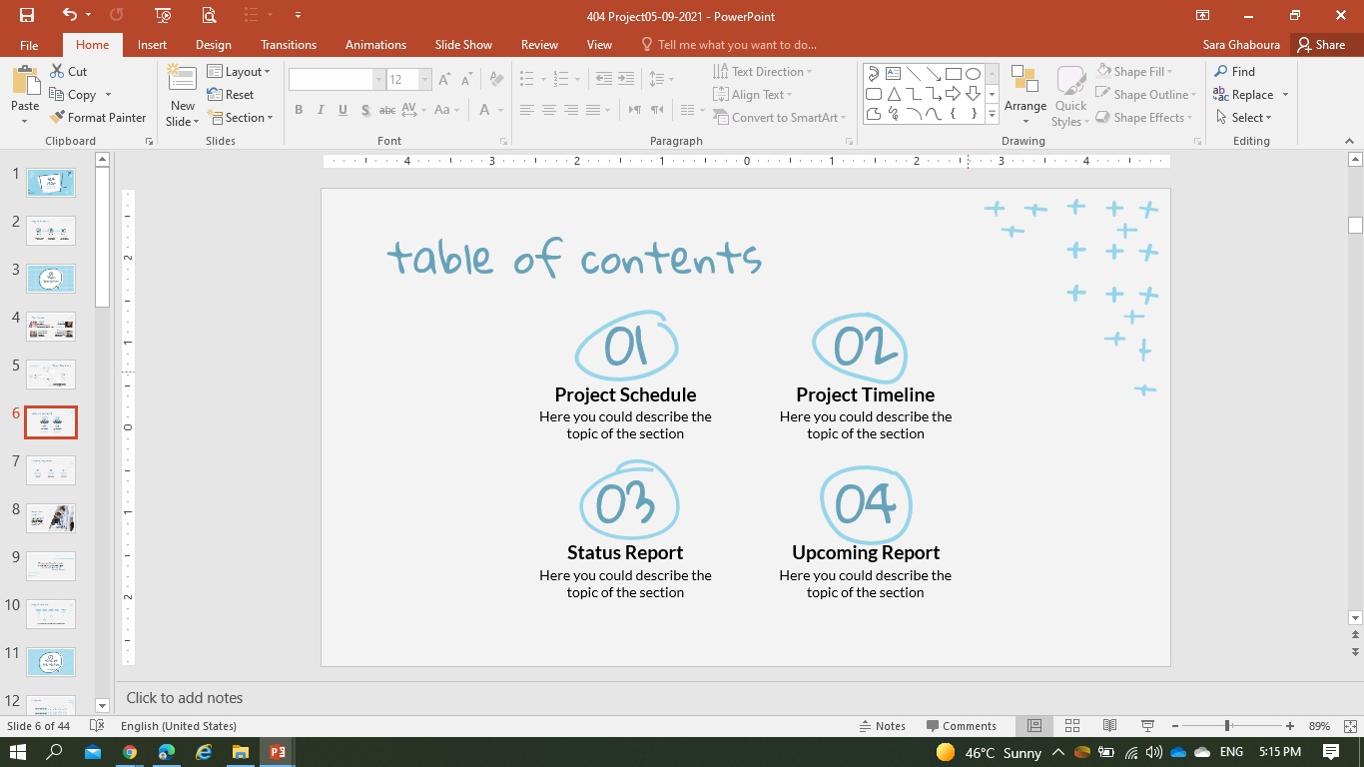
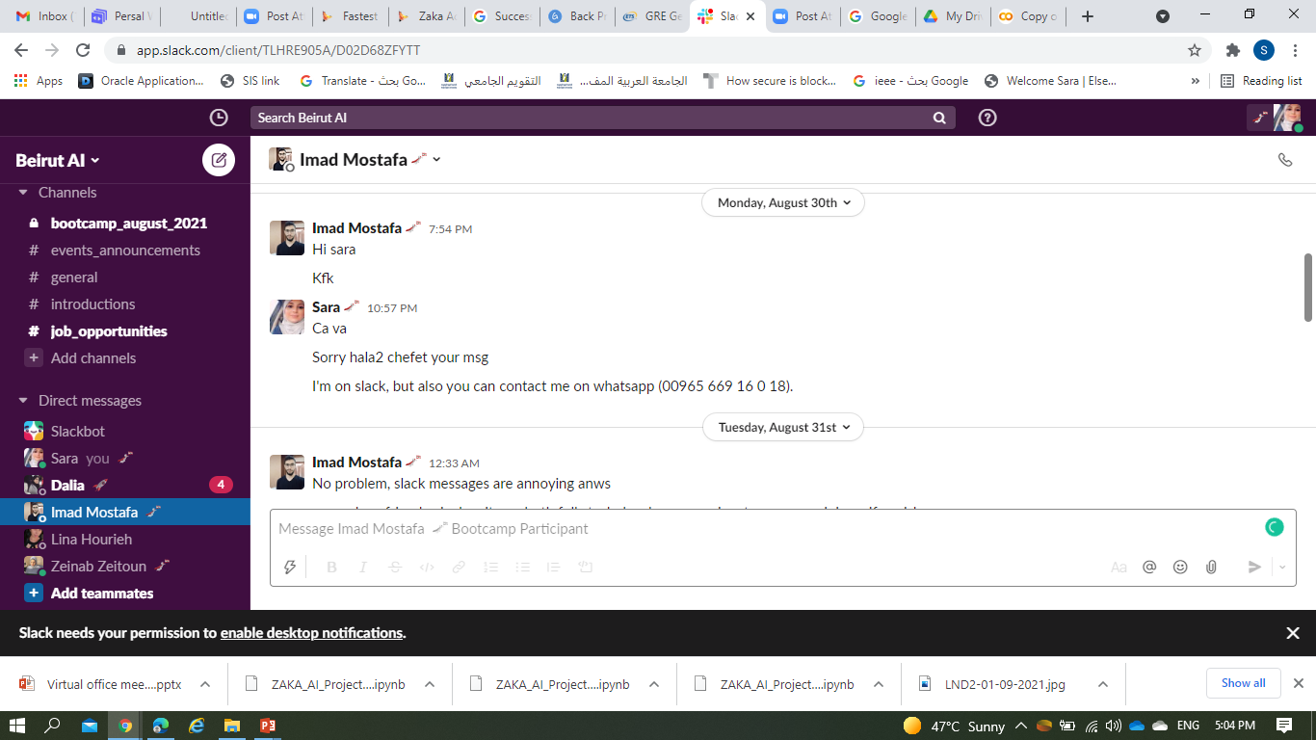

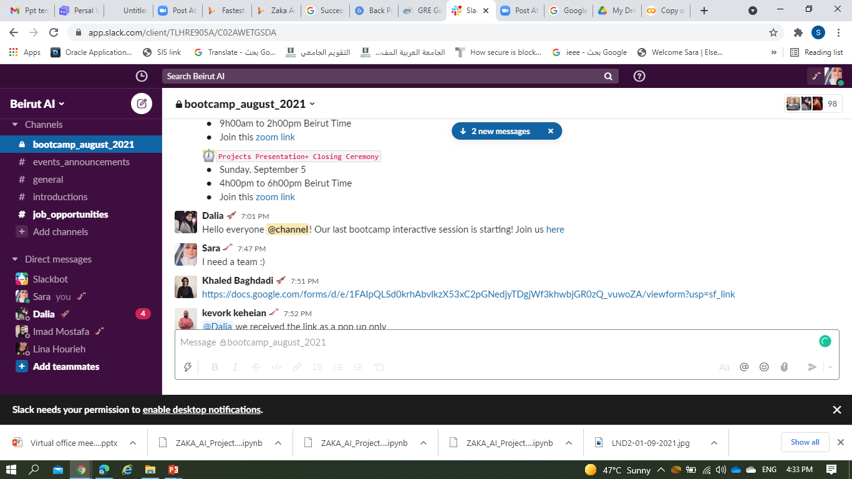
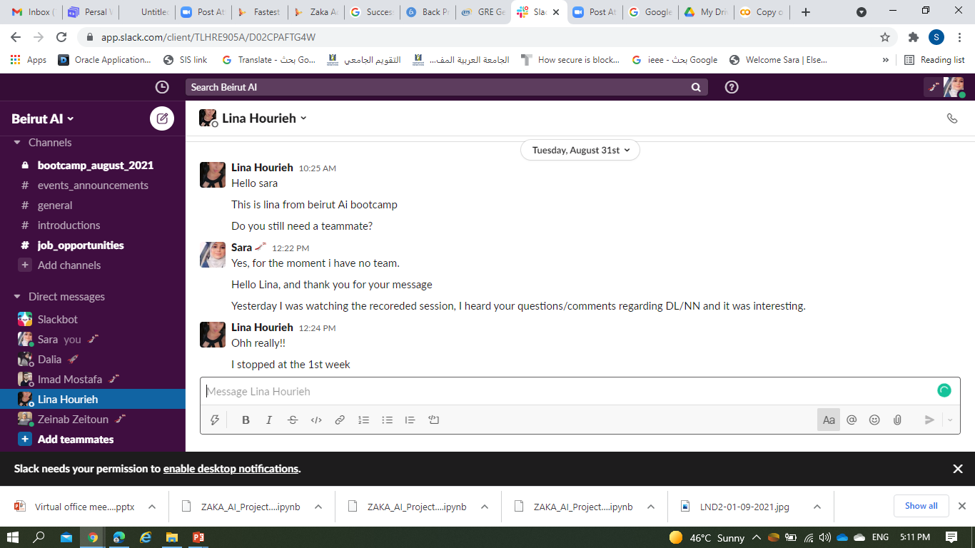
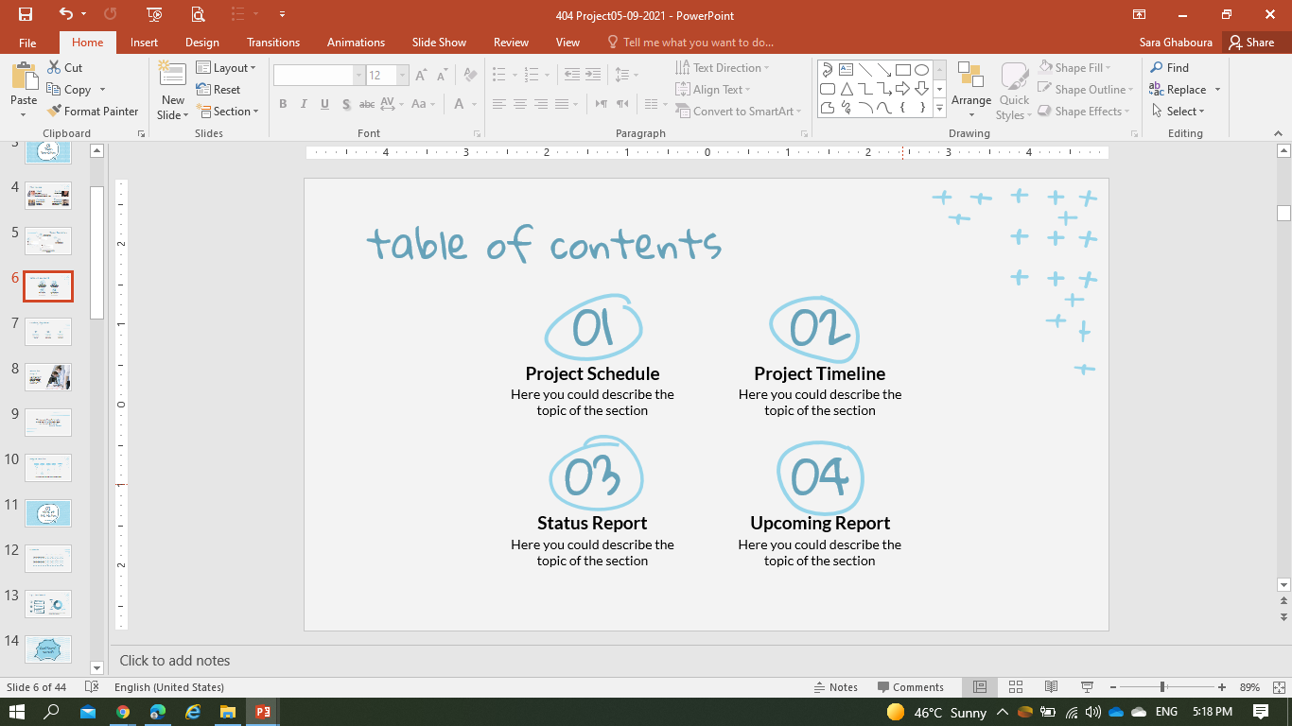
Team Formation
Imad contacted to join with his colleague Zeinab
Sara-Imad Conversation for 4 members groups
Sara desperate searching for a group on slack
Lina contacted, conversation occurred => Agree to work together and to check Imad request
The group is formed
The progress started

Slide 4
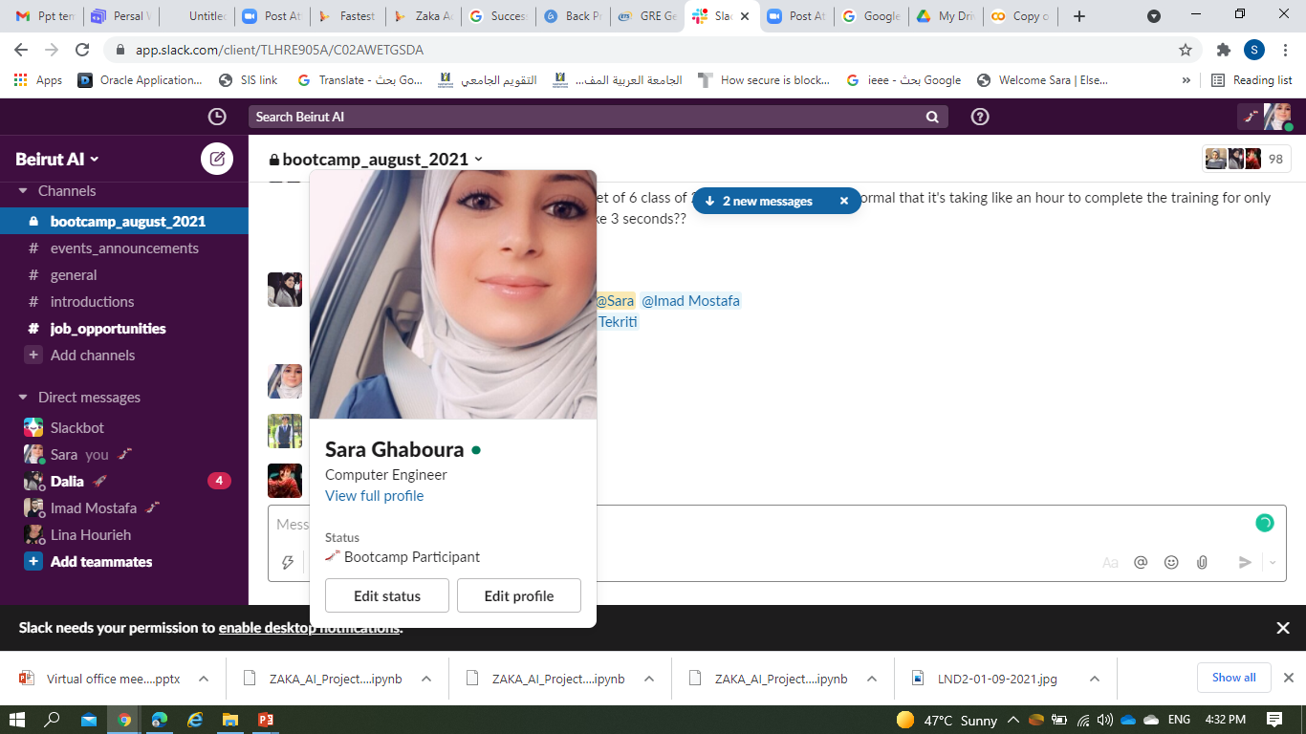
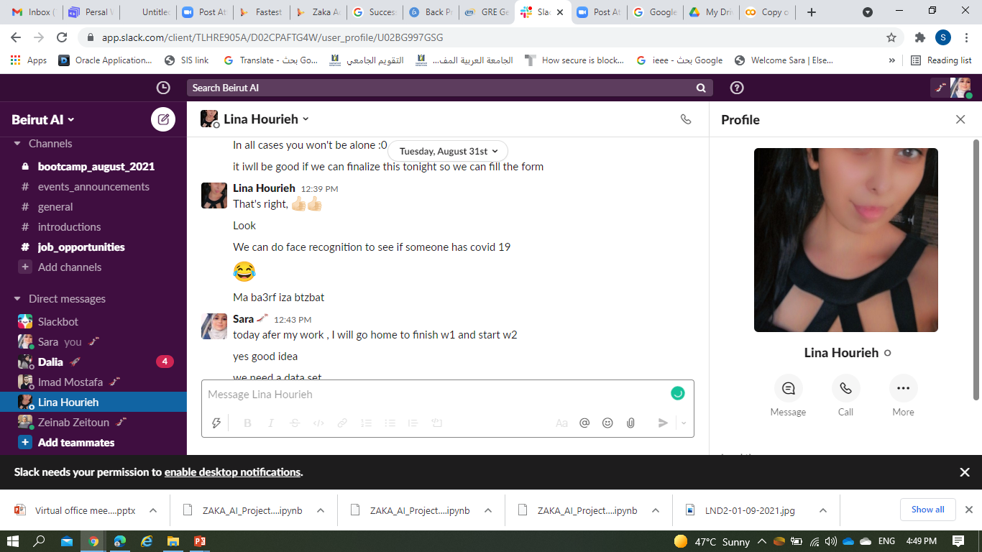
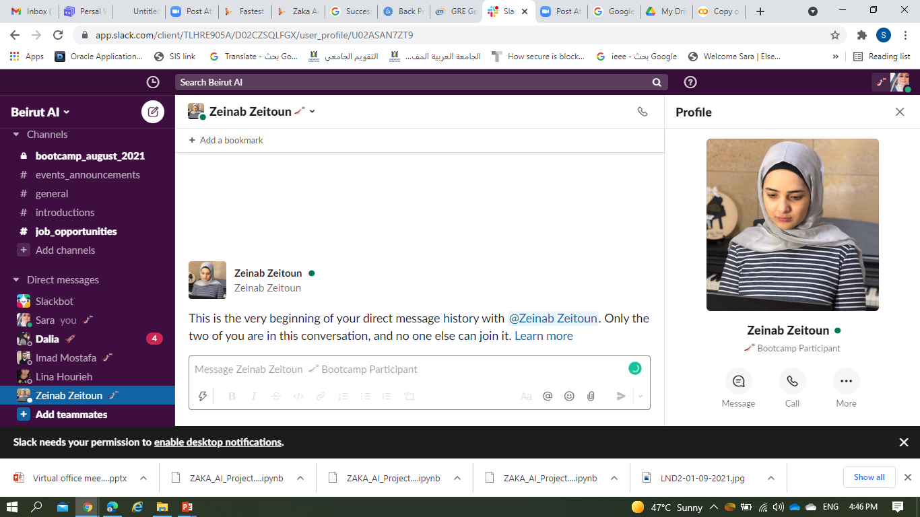
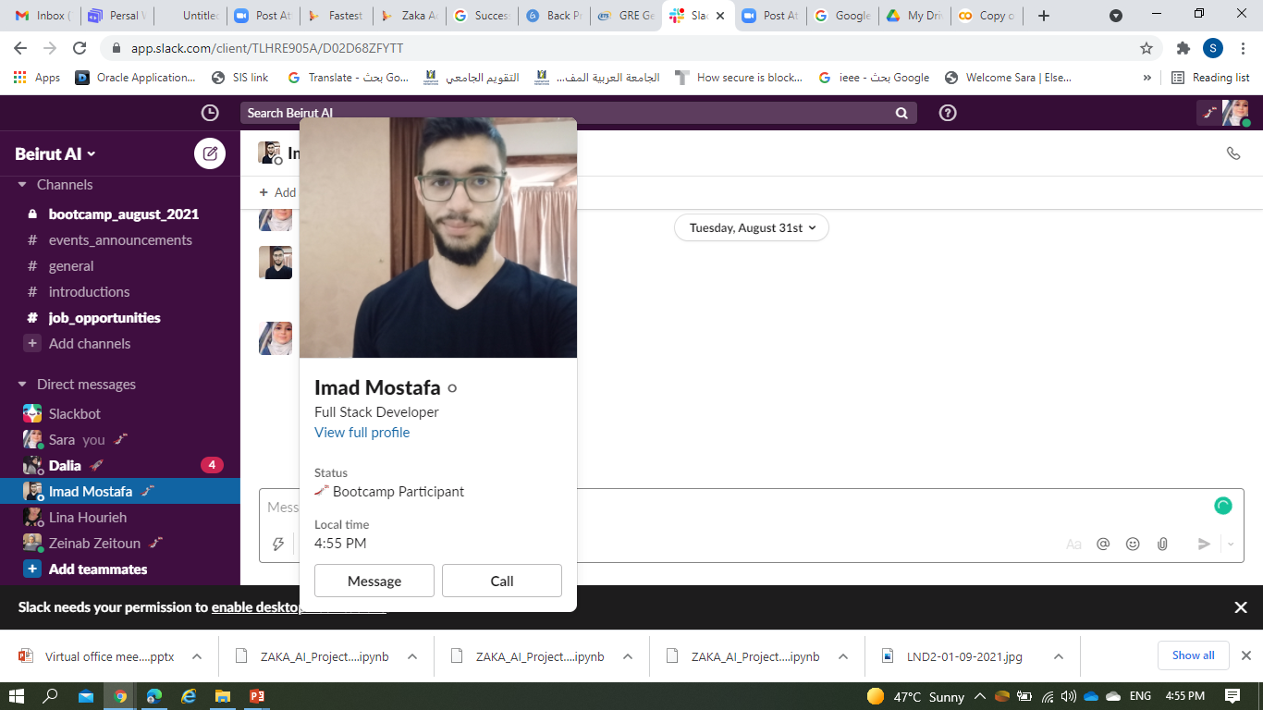
Who we are
Sara
Lina
Zeinab
Imad
PhD. Student
Neuroscience Student
PhD. Student Computer Engineering & Info –BAU
AI/DS Enthusiastic
Single mum of 3
BS. Biology –LU
MS. Neuroscience –LU
DS/AI Enthusiastic
Full Stack Developer
Full Stack Developer
BS. Mathematics – AUB
Full Stack Developer -Behumen
Las Year Mechatronics – LAU
Full Stack Developer -Behumen

Slide 5
-02-
About the project
It is not just a project,
It is a PRODUCT

Slide 6
Student Registration Status (SRS)
Our university is a non-profit foundation, started in few countries offering few programs.
Nowadays, the university is spread over more than 7 countries with more than 20 different programs.
Our project is based on real dataset made out of 31,000+ records.
The project plan is to be a “PRODUCT” serving our university any similar educational institute.

Slide 7
Why is SRS important?
$ Budget Accuracy /Profit
Optimizing Resources
Helping the students

Slide 8
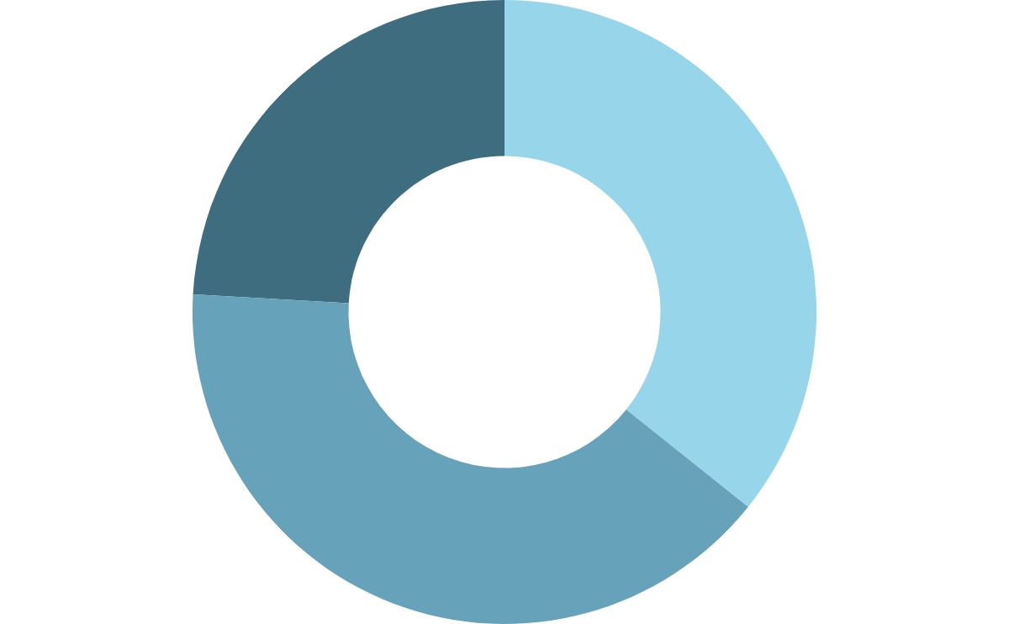
Solution?
GPA?
Traditional methods?
Time consuming
Hard to find the equation
Fees?
Social?

Slide 9
ML awesome

Slide 10
We are working on real dataset for a real confidential project

Slide 11
-03-
Implementation
Where the model is built

Slide 12
Steps
1 | Importing Libraries and Dataset | Getting all libraries in need, import the dataset into a data frame to start working on it
2 | EDA | Data visualization and insights
3 | Clean Dataset | Dropping unwanted data
4 | Splitting | Split the data in 80/20
5 | Encoding | Converting the categorical data into numerical
6 | Scaling | Sacling and Normalizing to eliminate domintant values 2 methods: Standard Robust
7 | Removing Multicollinearity | Help to spot redundent column and drop them
8 | Test Train Split | Train the model with 80% / then Test it with the 20% unseen data
9 | Model Building | 2 models: Decision Tree / Logistic Regression
10 | Reporting | Scores
11 | SHAP Analysis | Model deciphering and interpretation

Slide 13
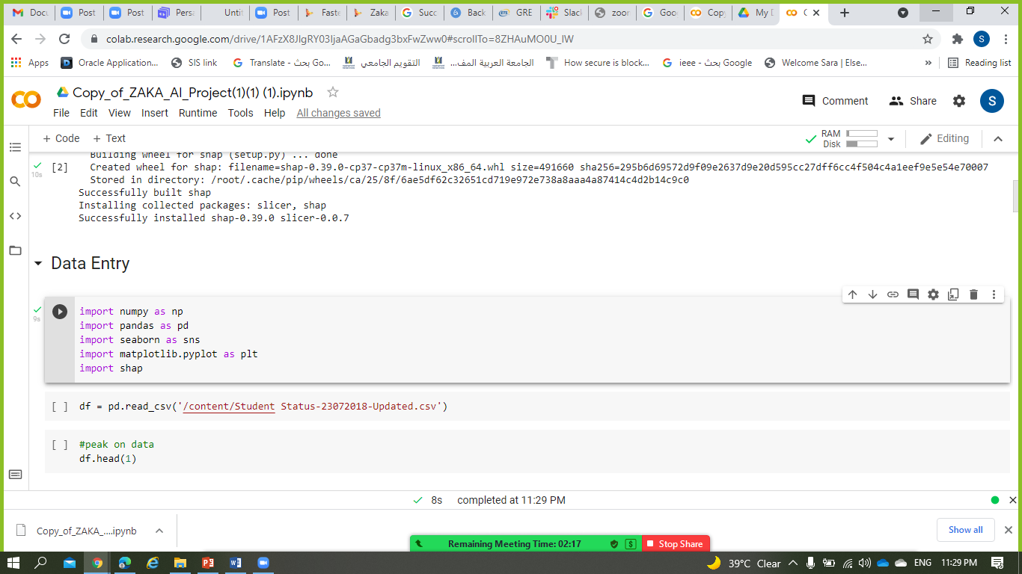
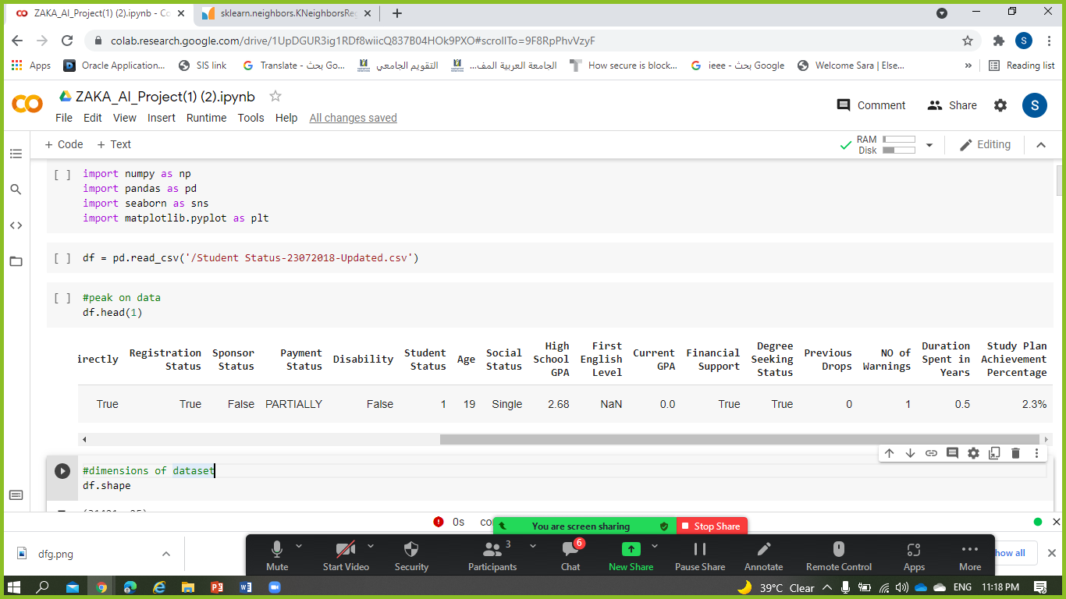
1- Importing Libraries and Dataset

Slide 14
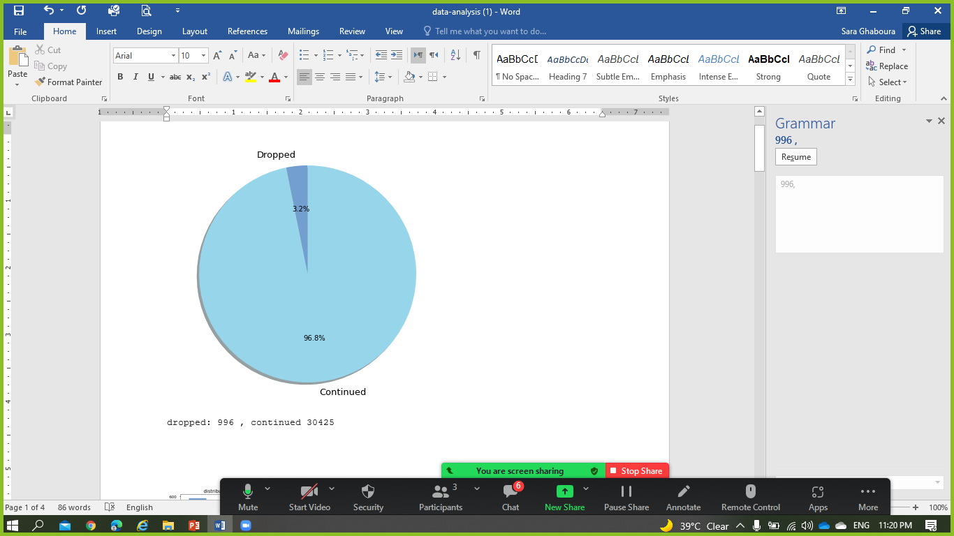
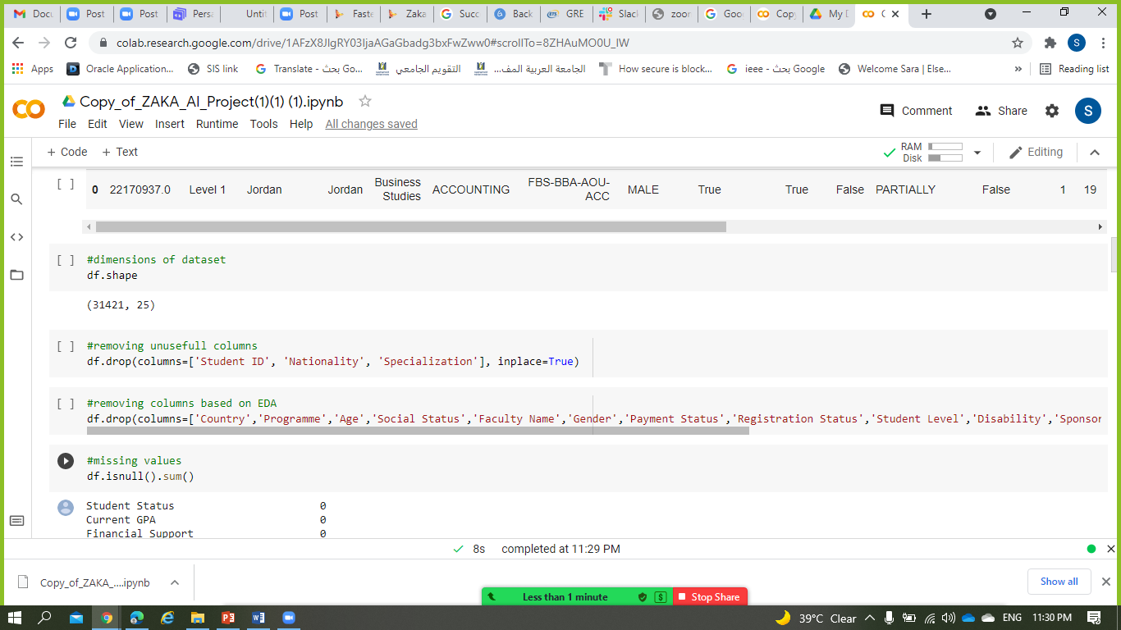
2- EDA

Slide 15
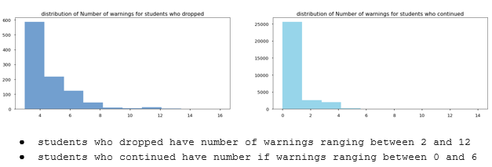
2- EDA
Students dropping tend to have more number of warnings

Slide 16
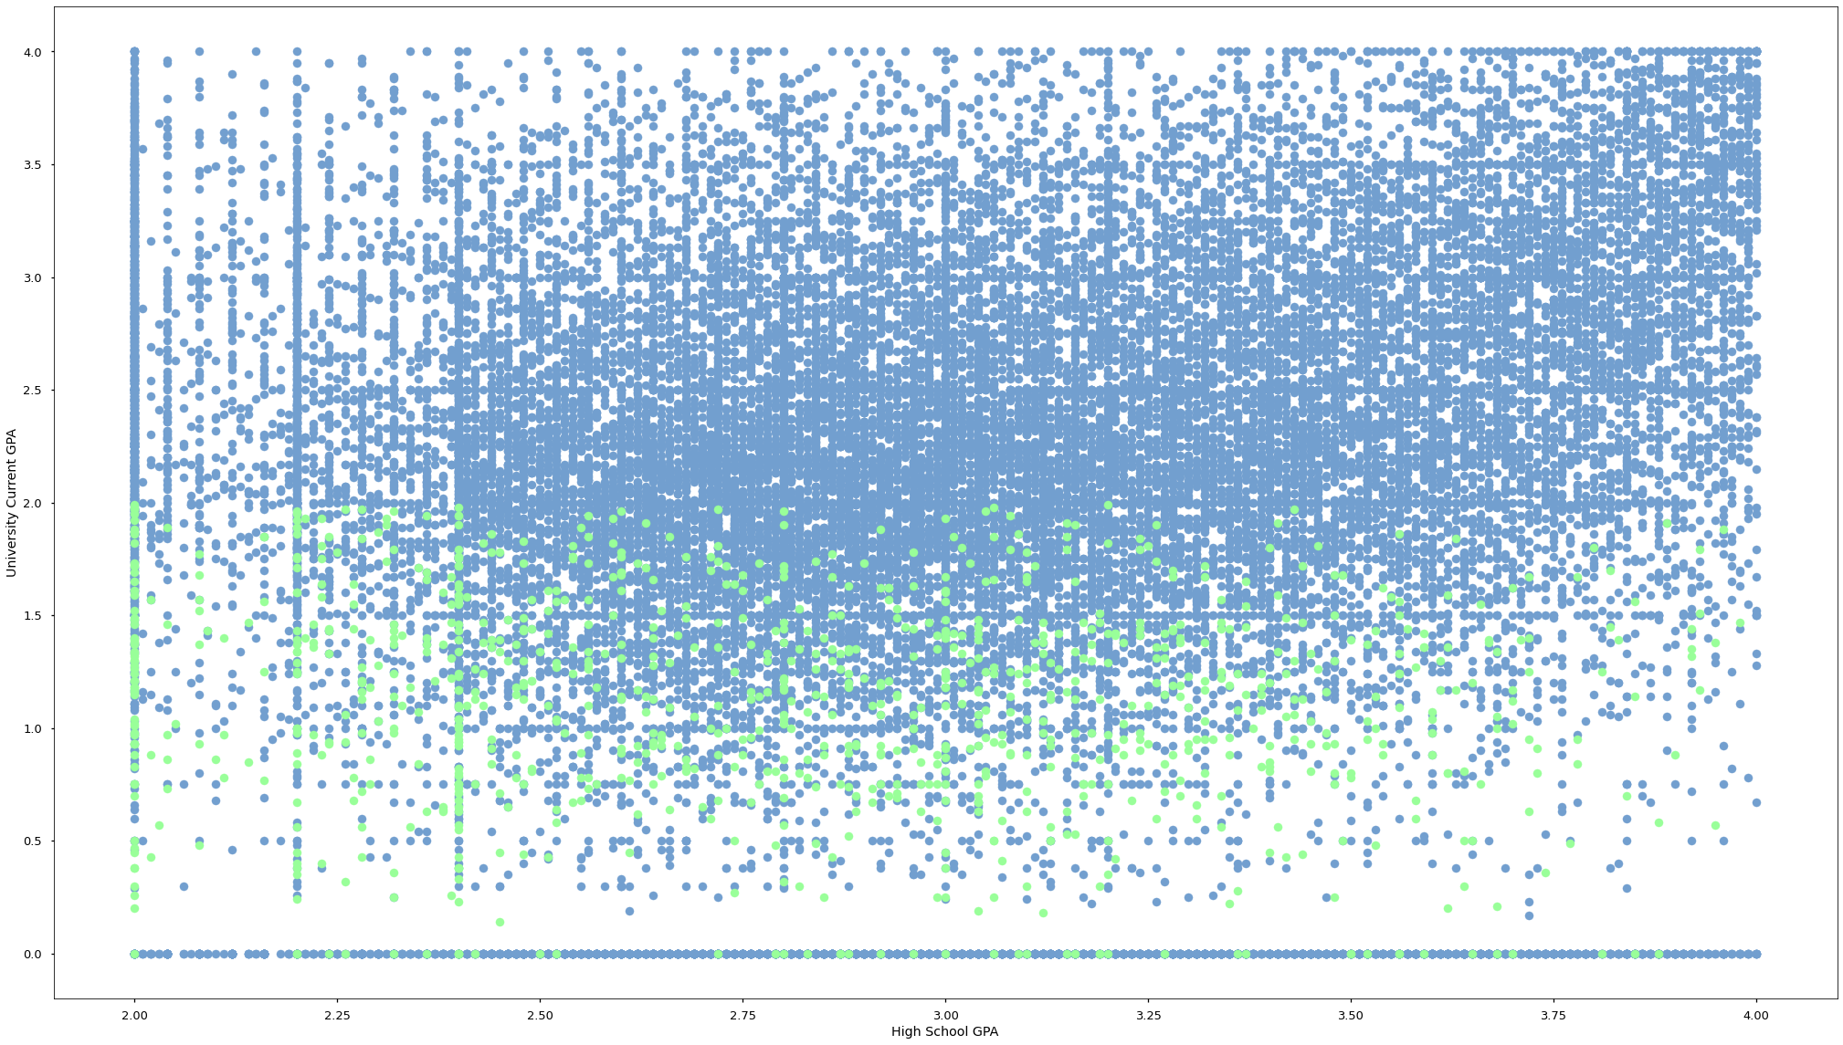
2- EDA
Blue: continuing students
Green: dropped students
Students who dropped tend to have lower GPA

Slide 17
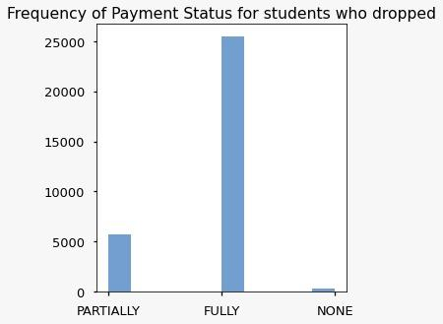
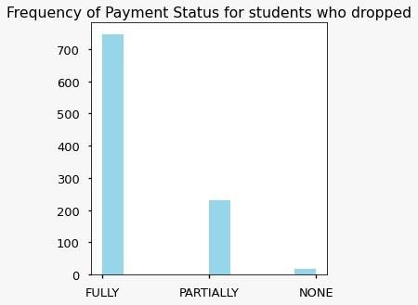
2- EDA
(ALL)
20% of students who didn’t pay any of their fees dropped out of university
where as only 3% of the students who fully paid the fees dropped

Slide 18
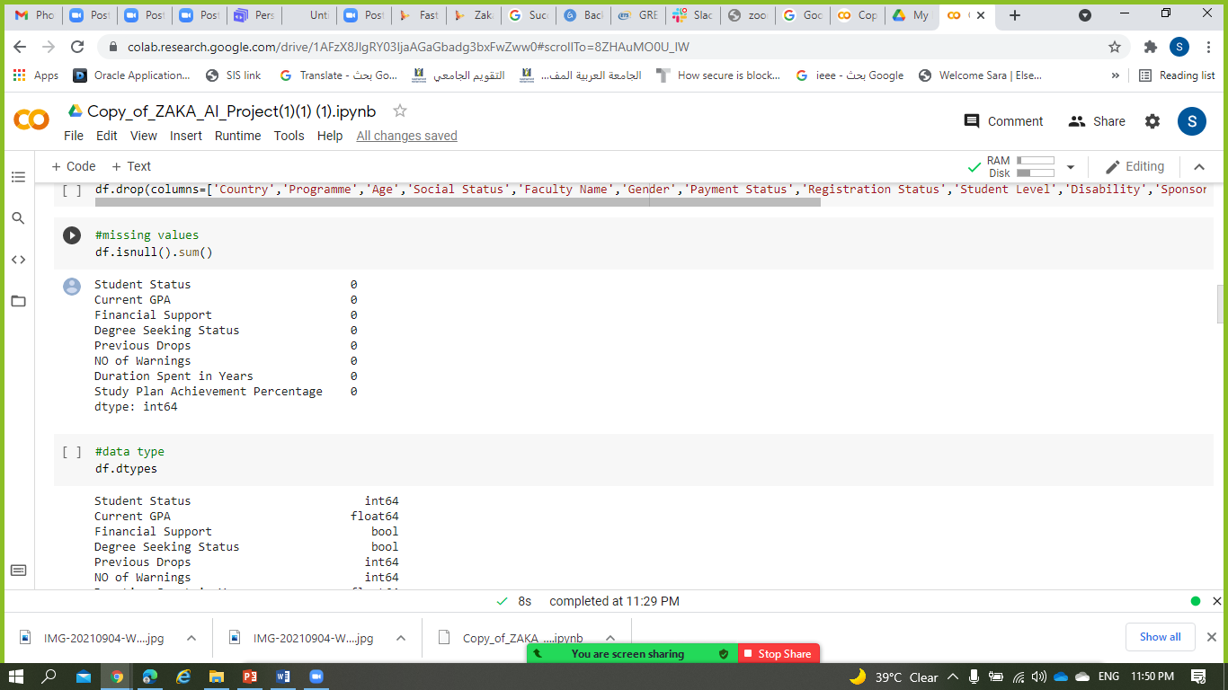
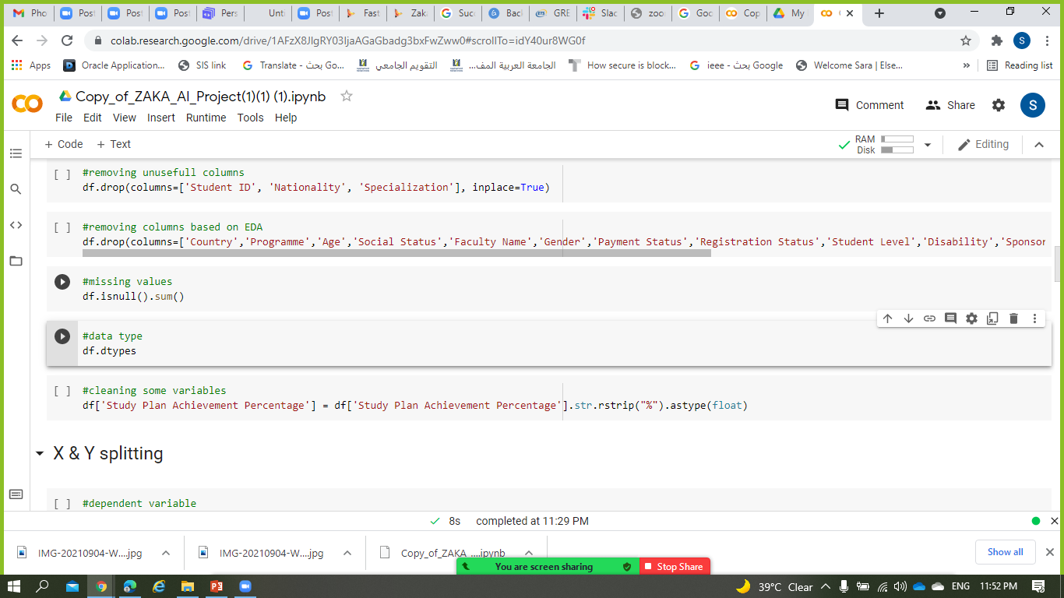
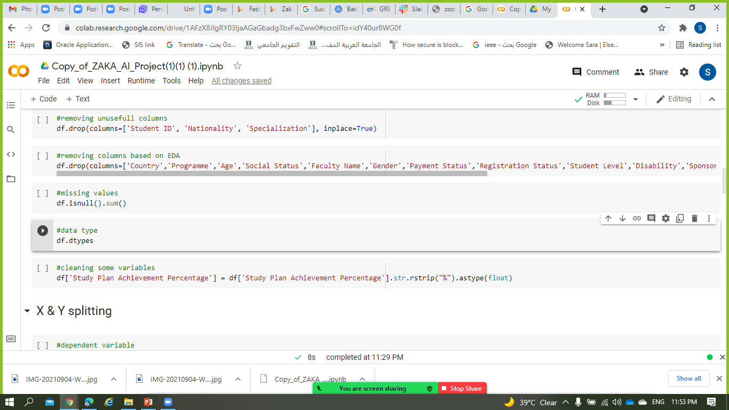
3- Clean Dataset

Slide 19
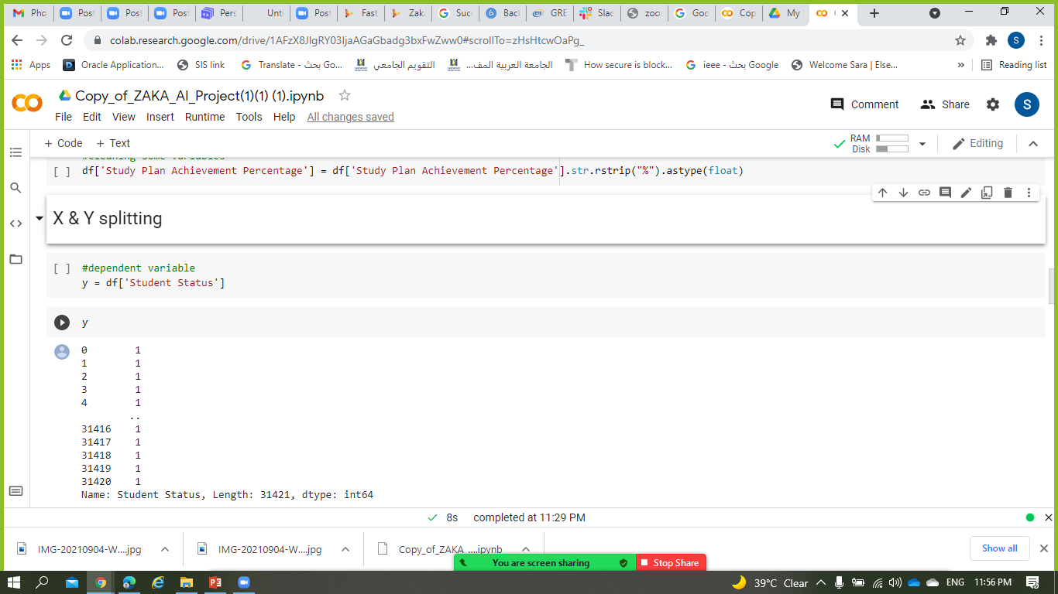
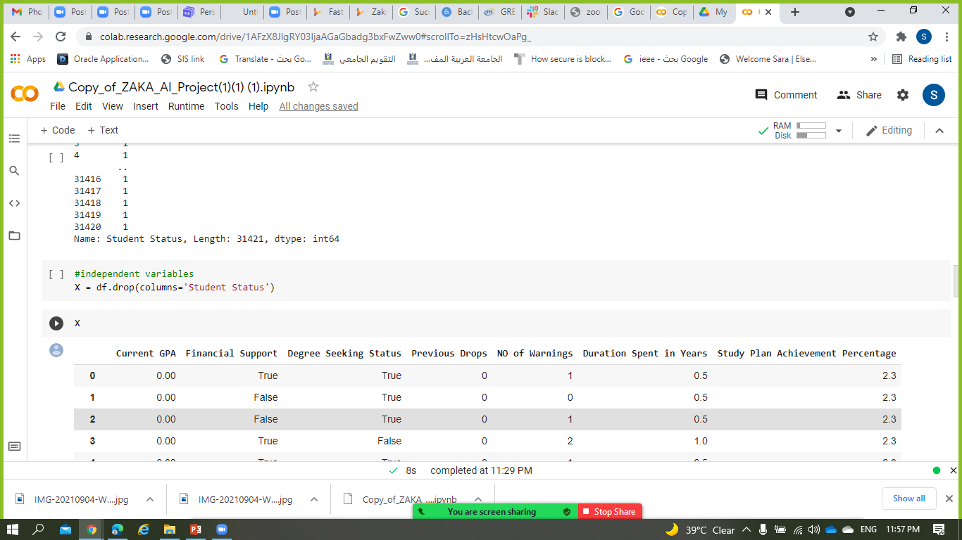
4- Splitting

Slide 20
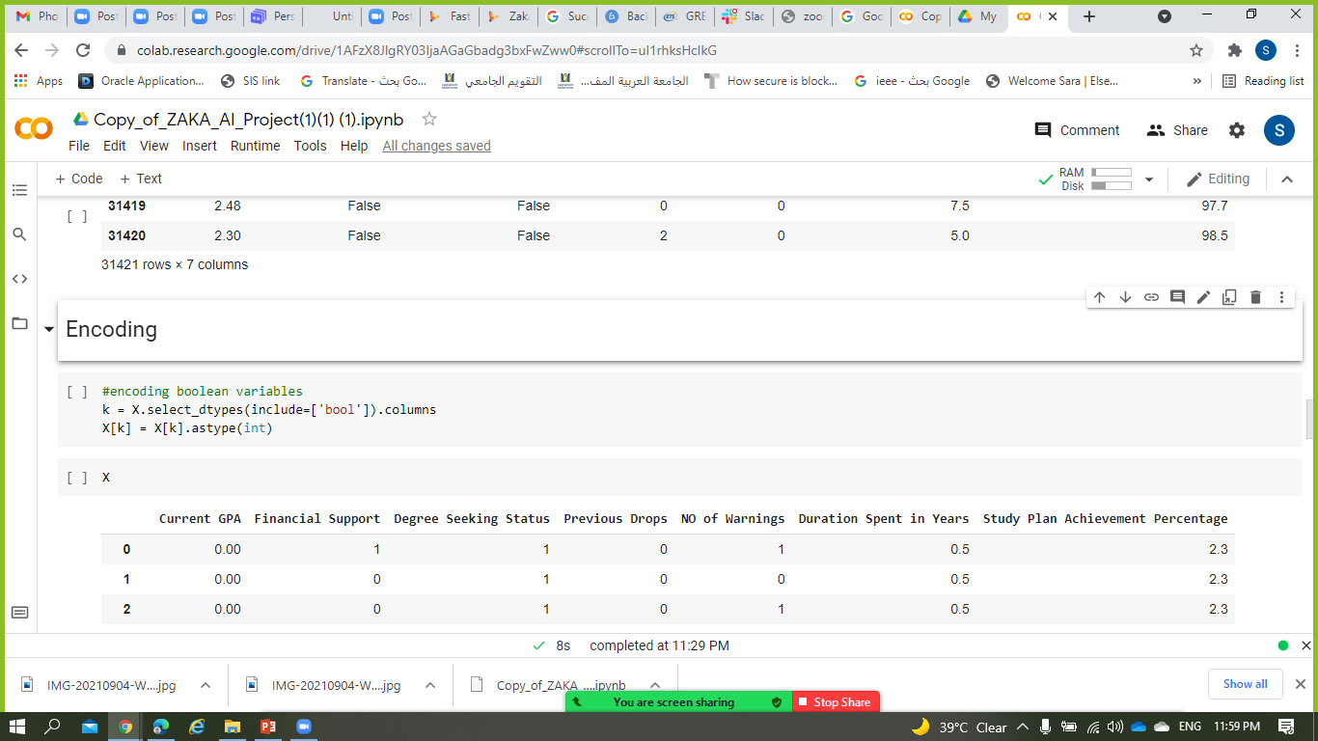
5- Encoding

Slide 21
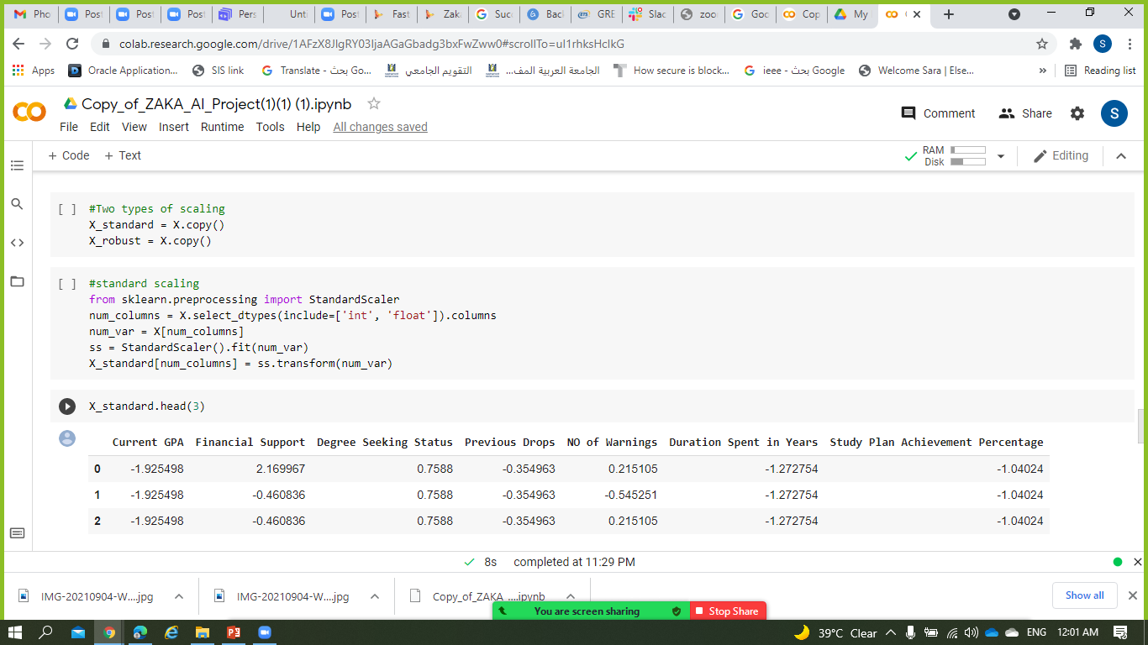
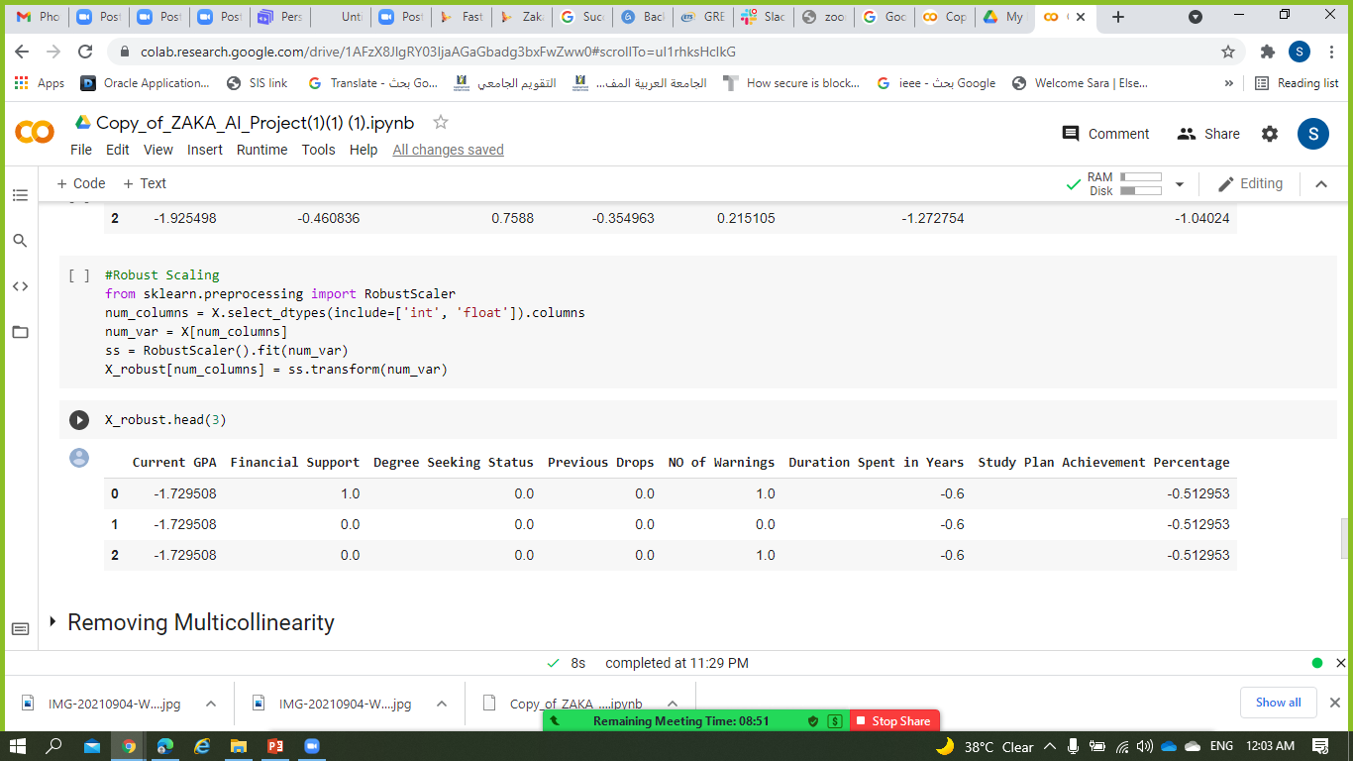
6- Scaling
A
B

Slide 22
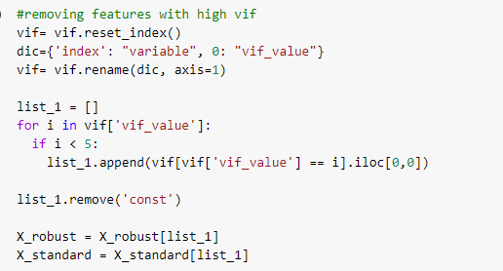
7- Removing Multicollinearity

Slide 23
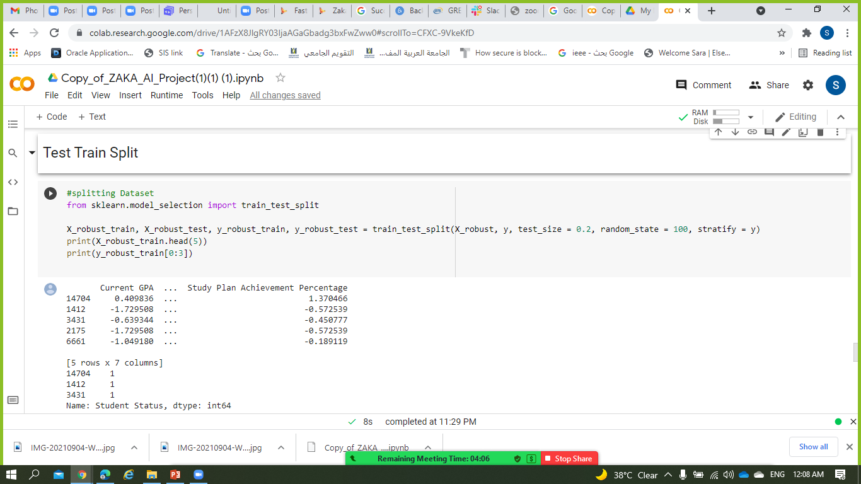
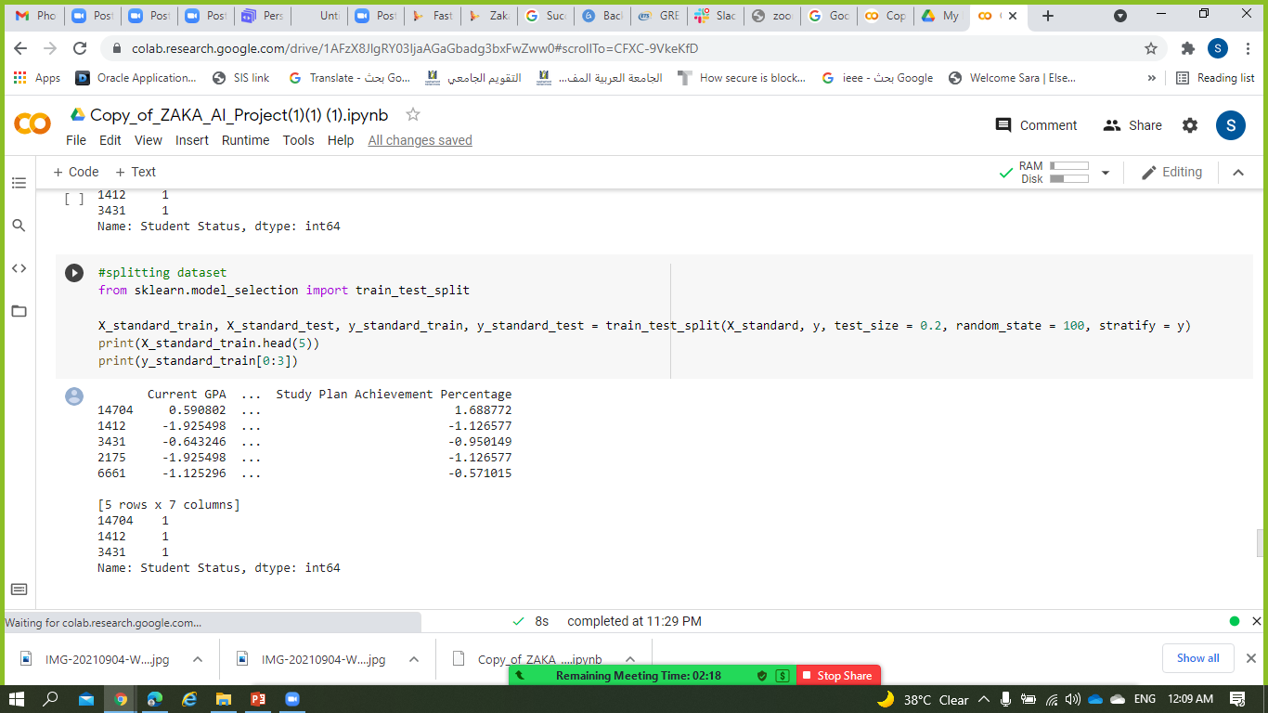
8- Test Train Split

Slide 24
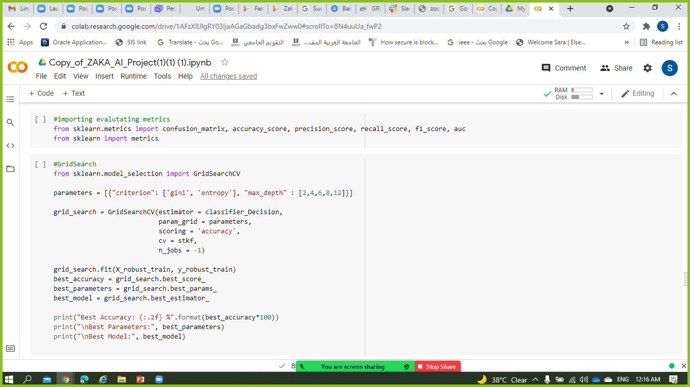
9- Model Building
A-Decision Tree
B-Logistic Regression

Slide 25
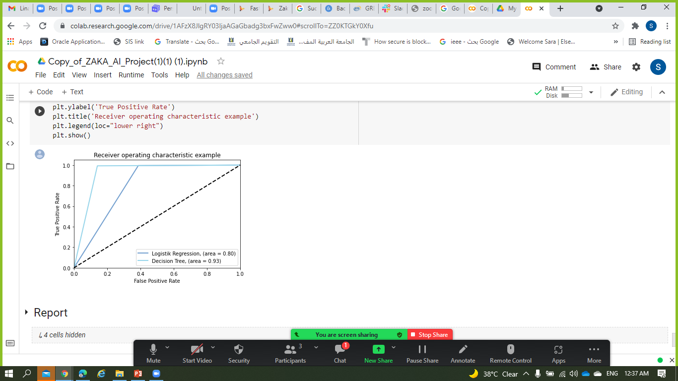
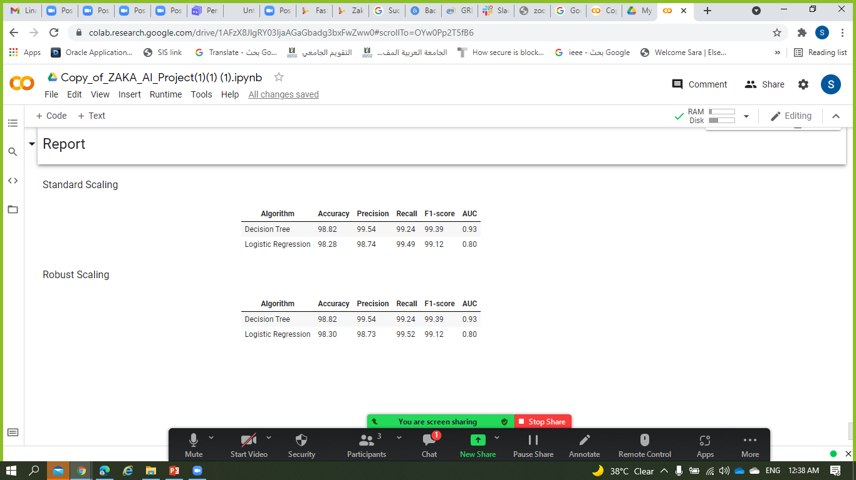
10- Reporting

Slide 26
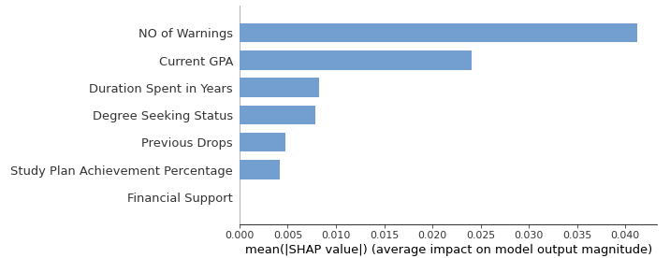
11- SHAP Analysis

Slide 27
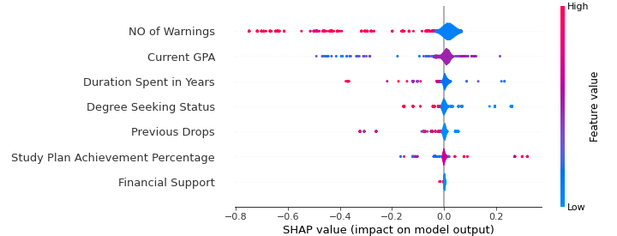
11- SHAP Analysis

Slide 28
-04-
Conclusion
Closing

Slide 29


Conclusion
Traditional method
AI methods

Slide 30
thanks!
Your questions are most welcomed
Zeinab: linkedin.com/in/zeinab-zeitoun/
Lina: linkedin.com/in/lina-hourieh-469533146/
Sara: linkedin.com/in/sara-ma-ghaboura-0069bb214/
Imad: linkedin.com/in/imad-moustafa/

Slide 31
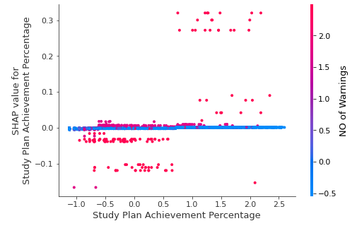
11- SHAP Analysis

Slide 32
-Jeff Bezos
“AI is in golden age and solving problems that were once in the realm of sci-fi.”

Slide 33
table of contents
01
02
03
04
Drop 🡪 burden on the budget + loss of expenses
Unbalanced budgets affect the whole body
🡪 reducing other costs/ shortcoming
🡪 reducing resources
Well understanding for the needs
Spotting the factors affecting the students, helping them to overcome the obstacles to continue their academic journey and building a better future
Team Formation
About the Project
Who we are
Concept, Dataset, Novelty
Implementation
Conclusion
Work organization, logic, coding
Closing

Slide 34
project Phases
Phase 1
Phase 2
Phase 3
Findind Dataset and cleaning it
Defining project scope and purpose
Implementing and analyzing

Slide 35
project schedule
wed | thu | fri | Sat | Sun
01 | 02 | 03 | 04 | 05
08 | 09 | 10 | 11 | 12
15 | 16 | 17 | 18 | 19
22 | 23 | 24 | 25 | 26
29 | 30 | 31
Kicking off the project
Getting the dataset
Demo 1
Data Manipulation
Prep for Sat Mentoring Session / Analysis Prep
Applying Rec + Finalizing

Slide 36
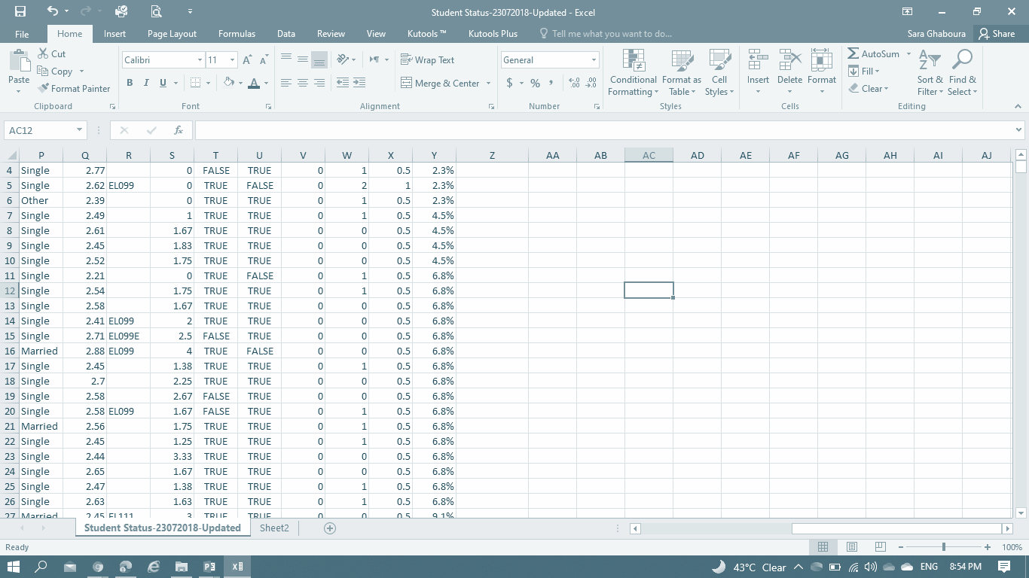

about the project
“Student Retention” and “Registration Expectation” for upcoming semester are ones of the main concerns of nowadays educational bodies.
Our project is a model that can predict the student status (Register/Drop) for the next semester based on several factors

